Slide 1
Software Maintenance

Slide 2
Software Maintenance
The process of modifying a software system or component after delivery to correct faults, improve performance or other attributes, or adapt to a changed environment.

Slide 3
Maintenance is thus concerned with:
correcting errors found after the software has been delivered
adapting the software to changing requirements, changing environments, ...

Slide 4
Kinds of maintenance activities
corrective maintenance: correcting errors
adaptive maintenance: adapting to changes in the environment (both hardware and software)
perfective maintenance: adapting to changing user requirements
preventive maintenance: increasing the system’s maintainability

Slide 5
Corrective maintenance
  Impractical to exhaustively test a large software system
  Therefore reasonable to assume that any large system will have errors
  Testing should be thorough for common cases, so errors likely to be obscure
  The process of receiving reports of such errors, diagnosing the problem, and fixing it is called "corrective maintenance"

Slide 6
Adaptive maintenance
  Systems don't function in isolation.
  Typically they may interact with operating systems, DBMS's, GUI's, network protocols, other external software packages, and various hardware platforms
  In the IT industry any or all of these may change over a very short period (typically six months)
  The process of assessing the effects of such "environmental changes" on a software system, and then modifying the system to cope with those changes is known as "adaptive maintenance"

Slide 7
Perfective maintenance
  Users and marketers are never satisfied
  Even if a system is wildly successful, someone will want new or enhanced features added to it.
  Sometimes there will also be impetus to alter the way a certain component of the system works, or its interface.
  The process of receiving suggestions and requests for such enhancements or modifications, evaluating their effects, and implementing them is called "perfective maintenance"

Slide 8
Preventative maintenance
  Sometimes changes are needed for entirely internal reasons
  Such changes have no direct discernible effect on the user, but lay the groundwork for easier maintenance in the future
  Alternatively, such changes may improve reliability, or provide a better basis for future development
  The process of planning such code reorganizations, implementing them, and testing to ensure that they have no adverse impact is known as "preventative maintenance"

Slide 9
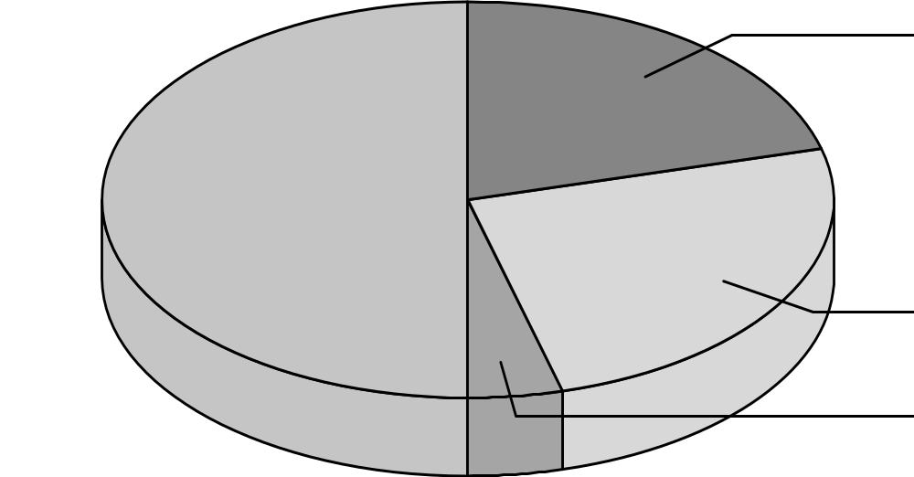
Distribution of maintenance activities
corrective 21%
perfective 50%
adaptive 25%
preventive 4%

Slide 10
Shift in type of maintenance over time
Introductory stage: emphasis on user support
Growth stage: emphasis on correcting faults
Maturity: emphasis on enhancements
Decline: emphasis on technology changes

Slide 11
Typical problems with maintenance
  Inadequate documentation of software evolution
  Inadequate documentation of software design and structure
  Loss of "cultural" knowledge of software due to staff turnover
  Lack of allowance for change in original software design
  Maintenance is unglamorous and may be viewed as a "punishment task"

Slide 12
Maintenance side-effects
  Any error or undesirable behavior that occurs as a result of modifications to a system
  Coding side-effects (inadvertent removal of vital code, changes in semantics of code, unexpected changes in execution path)
  Data side-effects (changes in data structures render older data invalid or incomplete, changes in global constants, changes in data ranges)
  Documentation side-effects (forgetting to document code or data structure changes, changes not reflected in user manuals or interface)

Slide 13
Software re-engineering
Reorganising and modifying existing software system (legacy system) to make them more maintainable.

Slide 14
Reengineering
Re-structuring or re-writing part or all of a legacy system without changing its functionality.
Applicable where some but not all sub-systems of a larger system require frequent maintenance
Re-engineering involves adding effort to make them easier to maintain. The system may be re-structured and re-documented.

Slide 15
When to Reengineer
When system changes are mostly confined to part of the system then re-engineer that part
When hardware or software support becomes obsolete
When tools to support re-structuring are available

Slide 16
Reengineering Advantages
Reduced risk
  There is a high risk in new software development. There may be development problems, staffing problems and specification problems
Reduced cost
  The cost of re-engineering is often significantly less than the costs of developing new software

Slide 17
Re-engineering
  Preventative maintenance (prevent foreseen maintenance nightmares)
  An extension of reverse engineering
  Use (or modify) the reconstructed design to generate new and better source code

Slide 18
Disadvantages of Software Reengineering
Practical limits to the extent of reengineering
Major architectural changes or radical reorganizing of the system data management has to be done manually
Reengineered system is not likely to be as maintainable as a new system developed using modern software engineering methods

Slide 19
Reverse Engineering
You have an unexpected case:
  You finished one course project using Java
  Your program runs OK
  But, by accident, you delete the java file
  How to hand in your project?
Reverse Engineering

Slide 20
Reverse Engineering
Forward Engineering
Reverse Engineering
Requirements
Design
Source Code
Behavior

Slide 21
Reverse Engineering
Abstraction System
Reverse Engineering
Abstraction
Forward Engineering
Re-Implementation
Old system
New System

Slide 22
Reverse Engineering
RE encompasses any activity that is done to determine how a product works, to learn the ideas and technology that were used in developing that product.
RE can be done at many levels
RE generally belongs to Software Maintenance

Slide 23
Scope and Task of Reverse Engineering
Redocumentation and/or document generation
Recovery of design approach and design details at any level of abstraction
Identifying reusable components and components that need restructuring
Recovering business rules
Understanding high-level system description.

Slide 24
Different Approaches
Reverse Engineering
  Design Recovery
    reproduce all the info for understanding the system
  Re-documentation
    provide different views of the system
Re-Engineering
  first phase --understanding the system
  second phase--forward engineering

Slide 25
Example--Java Decompiler
How to recover bytecode from .class file under Unix/Win with JDK?
  % javap -c <filename>
  % javap -help (to see the options)
Java Decompilers
  ”ClassCracker” http://www.pcug.org.au/~mayon/
  “DeCafe Pro" from DeCafe, France at http://decafe.hypermart.net/index.htm
  “SourceAgain" from Ahpah corp at http://www.ahpah.com

Slide 26
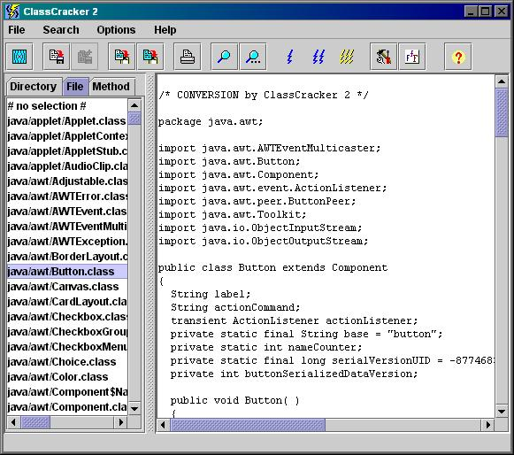
Example--Java Decompiler
ClassCracker 2 Interface

Slide 27
Example--Java Decompiler
Components of ClassCracker 2
  Java decompiler
    retrieves Java source code from Java class files
  Java disassembler
    produces Java Assembly Code
  A Java class file viewer
    displays Java class file structures.

Slide 28
Example--Java Decompiler
Features of ClassCracker 2
  User visual interface.
  Can decompile class files within zip or jar files.
  Conversion mode (JAVA, JASM or JDUMP) is selectable
  A Batc Mode allows multiple class files to be decompiled simultaneously
  more…...

Slide 29
Conclusions
Reverse Engineering is a new research area among software maintenance
RE includes activities of understanding the system and recovery info from system
Program understanding is the most important subset of Reverse Engineering
Discovery of abstraction is key issue

